Slide 1
Section 1.3 Lines
Lecture 2
Parallel and Perpendicular Lines

Slide 2
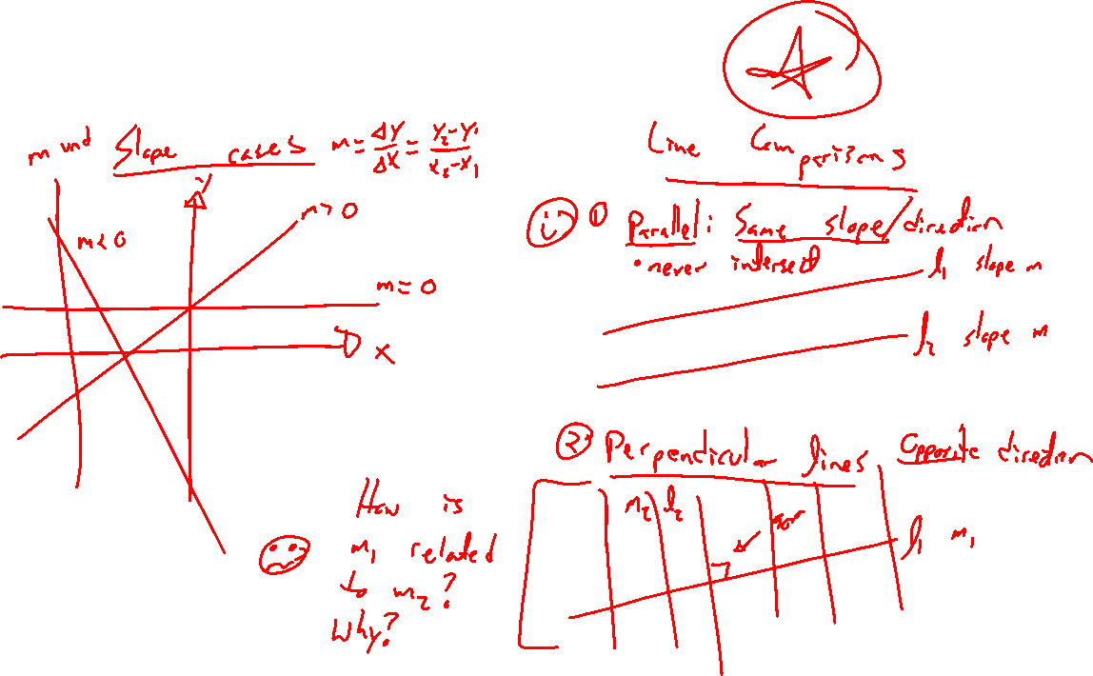
Recap: Types of Lines
Notes:
Pos, neg, zero, no slope.
Y=mx thru the origin (special case)
Parallel lines
(same slope, never intersect) / perpendicular lines
(opposite slope?, intersect at right angle)

Slide 3
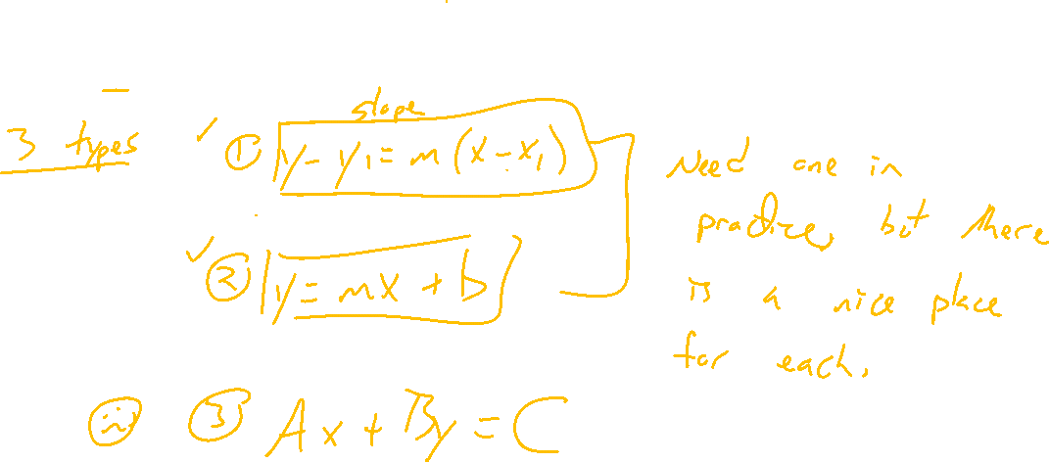
Recap: Equations of Lines
Notes:
2 main ones: point slope, slope intercept
Need 2 bits of information to use either one. (2 points, point/slope).
Can always use only one, choose your favorite.
Doesn't work for vertical lines.

Slide 4
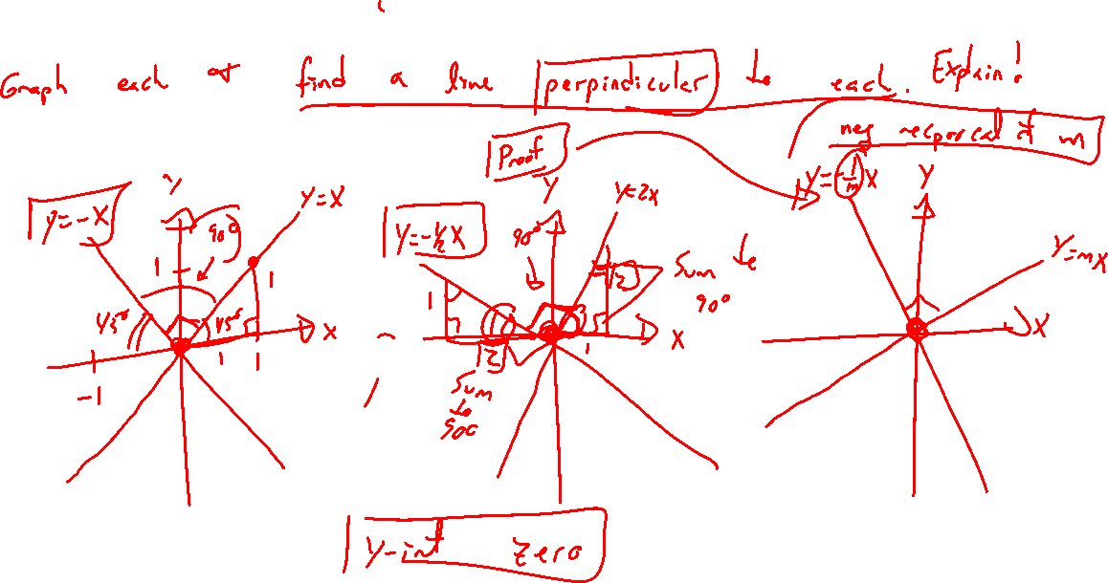
Perpendicular Lines: Try on Own
Notes:
Y=x, what is perpindicular?
Y=2x? Draw 1,2 and 2,1 right triangles. Argue middle is 90 degrees.
Y=mx? Draw 1,m and m,1 right triangles. Show m=-1/m_p is the equation for perpendicular slopes
How to show they form a right angle using geometry and complementary angles

Slide 5
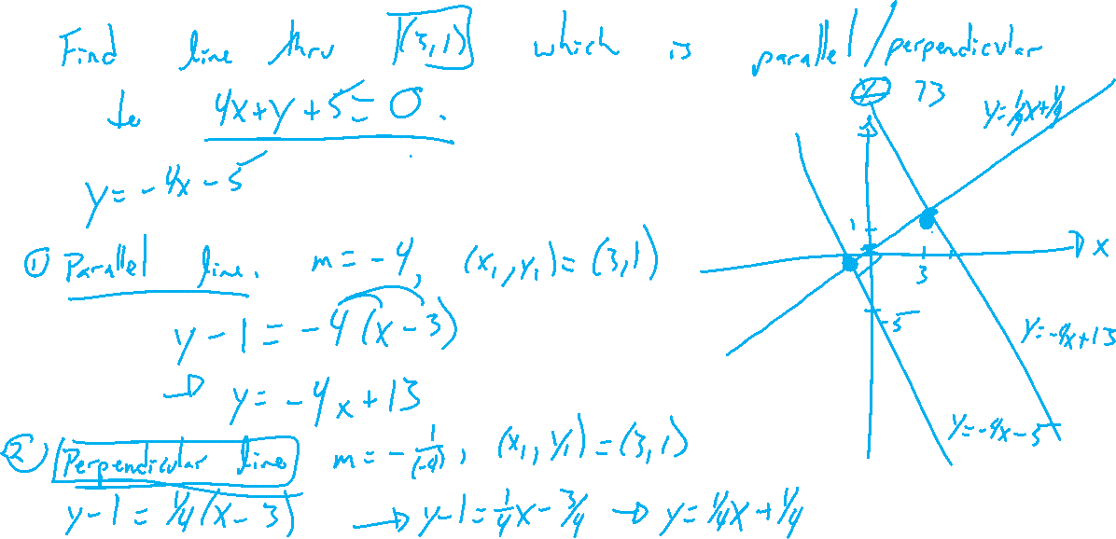
Example: Try on Own
Notes:
Find the line thru point (3,1) which is parallel / perpendicular to line 4x+y+5=0.
Check in Desmos

Slide 6
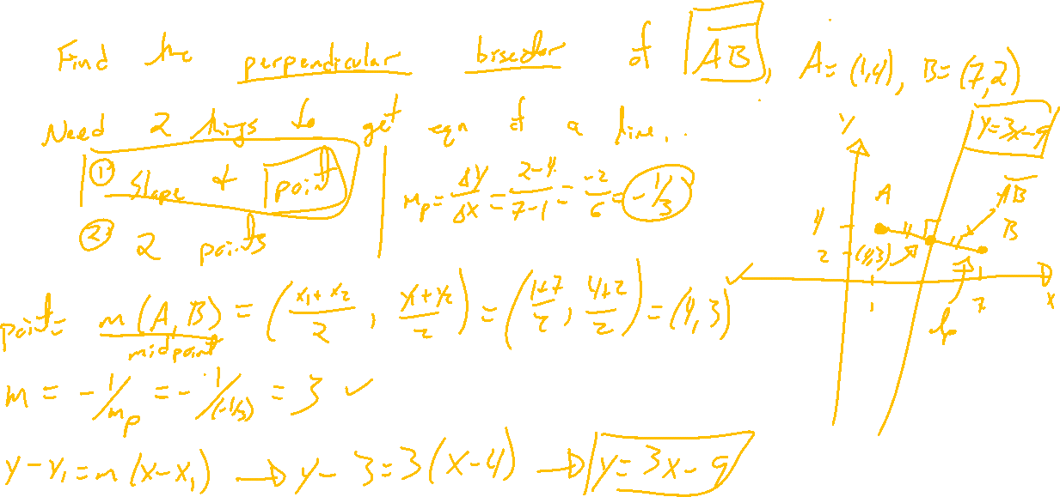
Example: Try on Own
Notes:
Find the perpendicular bisector of segment AB where A=(1,4), B=(7-2). Find its x and y intercepts
Check in Desmos

Slide 7
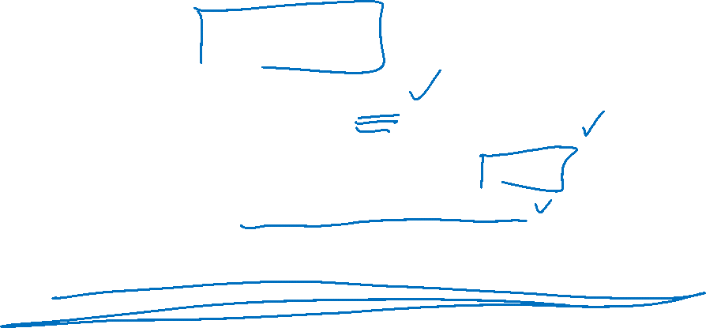
Section 1.3: Textbook Examples and Exercises
Rework examples 2, 3, 6, 7, 8, 9 in the text. Steps:
Write down a problem.
Close the book and attempt on own.
Check / correct your solution against the text solution.
If needed, rewrite the problem to be of the quality of the text solution.
Complete exercises 19, 27, 29, 47, 49, 61, 67
Write solutions of the same quality as in lecture and text solutions.
Check your solution against the answer in the back of the book.

Slide 8

Section 1.3 Homework Submission to Canvas
Preview of section
Skim the section in text and write a short paragraph summary.
Give a bulleted list of all important definitions, theorems, and formulas without details.
Notes on video lectures
Take notes on everything written on slides including all details, worked examples, on-own activities, as well as your own thoughts and questions.
Try on-own activities first, then write down provided solution next to it for comparison.
Worked examples from the text
Write down the problem and attempt without looking at the solution.
Use the solution to write the best explanation you can.
Solutions to textbook exercises
Model approaches and explanations given in the video lectures and textbook examples.
Final reflection of section
List the key takeaways to remember as a bulleted list.

